Slide 1


BillWise Pro: An Integrated Billing, Accounting, Inventory
Management, and Invoice Generation System for SMEs
Dev Varshney (2200290129009)
Shreshthi Tayal (2100290120160)
Vanshika Jain (2100290120186)
Viyapi Tyagi (2100290120195)
Supervised By:
Dr. Akash Goel

Slide 2
Project Abstract
Overview
Key Objectives
Approach
BillWise Pro is a web-based solution designed for small and medium-sized enterprises (SMEs) to streamline core business functions, including billing, accounting, inventory management, and invoice generation. It addresses the inefficiencies and human error associated with manual processes by integrating these tasks into a single, user-friendly platform.
Simplify and automate billing, inventory tracking, and customer management to improve operational efficiency.
Provide SMEs with an affordable, secure, and scalable solution that minimizes data entry errors and enhances productivity.
Enable real-time data tracking, easy report generation, and centralized management of key business functions.
BillWise Pro is developed with a component-based front-end using React and Tailwind CSS, a back-end powered by Express.js and Node.js, and a MySQL database for reliable data storage. It follows an agile development model, implementing secure user authentication, a user-friendly interface, and continuous improvements based on user feedback.

Slide 3
Project Goals and Objectives
Enhance Operational Efficiency for SMEs
1
Streamline billing, accounting, inventory, and invoice management processes to reduce reliance on manual tasks and minimize time spent on routine operations.
Automate key functions like sales and purchase tracking, inventory updates, and customer billing, enabling users to focus on core business activities.
2
Improve Data Accuracy and Security
Minimize human error in financial and inventory records through automated data entry and verification.
Ensure secure access to business data with OTP-based login and user authentication, protecting sensitive financial information.
Provide Cost-Effective, Scalable Solution
3
Offer an affordable subscription model, allowing SMEs to access robust enterprise-level tools without high upfront costs.
Design a scalable system architecture capable of growing with the business, supporting additional features and more users as needed.
.

Slide 4

Alignment with UN Sustainable Development Goals (SDGs)
SDG 8: Decent Work and Economic Growth
SDG 9: Industry, Innovation,
and Infrastructure
Promote sustained, inclusive, and sustainable economic growth, full and productive employment, and decent work for all.
BillWise Pro enhances operational efficiency for SMEs, allowing small business owners to focus on growth and innovation rather than time-consuming administrative tasks. By streamlining billing, inventory management, and invoicing processes, it helps SMEs increase productivity, improve business performance, and generate more sustainable job opportunities.
Build resilient infrastructure, promote inclusive and sustainable industrialization, and foster innovation.
The project leverages cloud-based technologies and automation to provide SMEs with an affordable and scalable business solution, fostering innovation and the digital transformation of traditional industries. BillWise Pro empowers SMEs to improve their business infrastructure by integrating essential functions into one user-friendly platform.

Slide 5
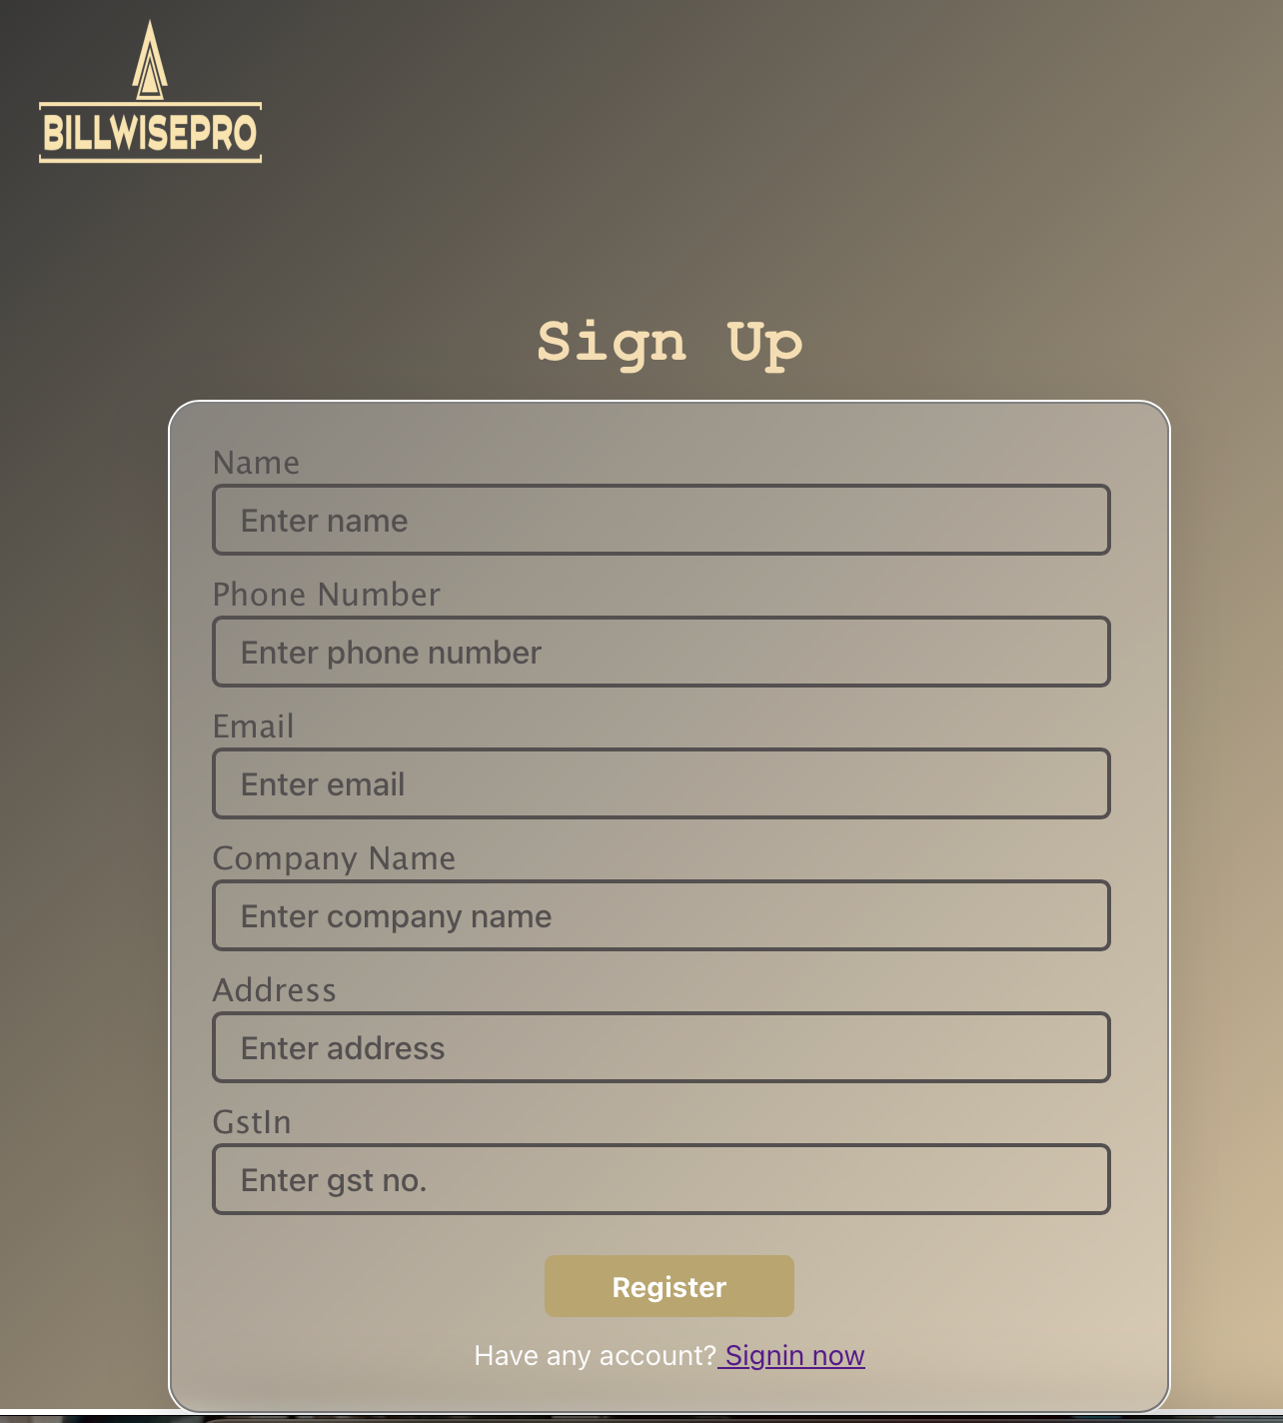





Methodology and Approach
Agile Development Methodology
Agile (Scrum) was used for iterative development and frequent updates. Features were developed in short sprints with continuous feedback and rapid adjustments.
Component-Based Architecture (Front-End)
The front-end was built with React and Tailwind CSS, using reusable components to improve maintainability and scalability.
RESTful API Architecture (Back-End)
Express.js and Node.js were used for the back-end with RESTful APIs for efficient communication and OTP-based authentication.
Database Management
PostgreSQL was used for data storage with normalized tables to ensure data integrity.

Slide 6
Expected Outcomes and Impact
Enhanced Operational Efficiency
Cost Reduction for SMEs
Improved Data Accuracy and Decision
Making
Outcome: BillWise Pro streamlines and automate core business processes such as billing, inventory management, and accounting.
Impact: This automation will significantly reduce manual workload, minimize human error, and accelerate routine operations, resulting in improvement in workflow efficiency for SMEs.
Outcome: BillWise Pro offers a cost-effective alternative to traditional ERP systems by eliminating high licensing, infrastructure, and maintenance costs.
Impact: SMEs can now access essential enterprise-grade features without financial strain, allowing them to reallocate savings toward strategic growth areas.
Outcome: Integrated real-time tracking of inventory, sales, and financials will ensure consistent and up-to-date data availability.
Impact: Businesses will be empowered with accurate insights, enabling data-driven decisions, improved cash flow management, and proactive planning.

Slide 7
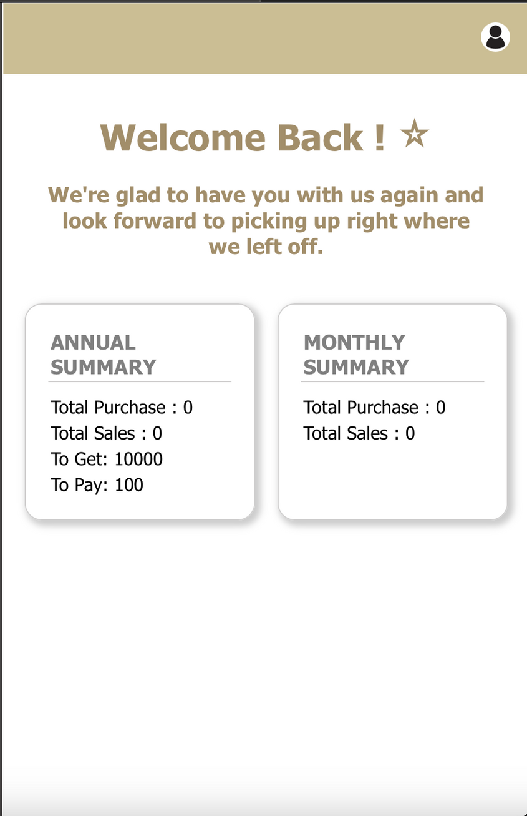
Key Project Deliverables
Fully Functional Web Application
A fully functional system for billing, inventory, and accounting management.
User Documentation
A manual with setup instructions and usage guidelines.
Performance & Security Report
A report on system performance and security measures.

Slide 8
Next Steps and Conclusion
1
User Testing
2
System Optimization
3
Deployment & Support
Conduct comprehensive testing with real-world users to gather feedback and improve functionality.
Refine performance, enhance features, and fix any identified bugs.
Launch the system, provide user support, and monitor system performance for ongoing improvements

